Slide 1
Interfaces - Abstract class - Packages
Object Oriented Programming with Java
Chapter 4
FPTU Da Nang - IT Department

Slide 2
Content
Interface concept
Design & implementation of interface
Abstract method and abstract class
Package concept
Package definition and usage
Common modifier keywords

Slide 3
Interface
Interface is a blueprint – template for a class, for new reference type.
  unified programming interface
  support team-work
  allow multiple inheritance in Java
Syntax :
  public interface InterfaceName {
  // static final
  // abstract method;
  // default method;
  }
  static final : sharing constants for all classes of an application.
  abstract method: method with no body, will be defined by the classes that implement the interface
  default function declared with the default keyword at the beginning of the method signature
  All member of interface are public by default

Slide 4
Interface..
public interface Shape {
double Pi=3.1416;
public double perimeter();
public double area();
public default void display(){
System.out.println(“This is a shape”);
}
}
Important note when design and implement an interface
  An interface can inherit one interface or multiple interfaces
    public interface MouseAction extends MouseListener, MouseMotionListener
  All members of interface are default accessed by public
  The variable declarations in the interface are static and final – so they must be initialized
  Final methods are not allowed

Slide 5
Implementation class
Syntax
  Using keywords implements
  public class Rectangle implements Shape {
  private double length, width;
  public double area() { return length*width; };
  public double perimeter() { return 2*(length+width);}
  }
Important notes:
  implementing class must define all abstract methods of interface.
  A class can inherit only 1 base class but can implement many interfaces: multiple inheritance
  public class Student extends Person implements Comparable, Serializable{ …}
  interface type variable can take the instance of the corresponding implementing class
    Shape cn= new Rectangle();

Slide 6
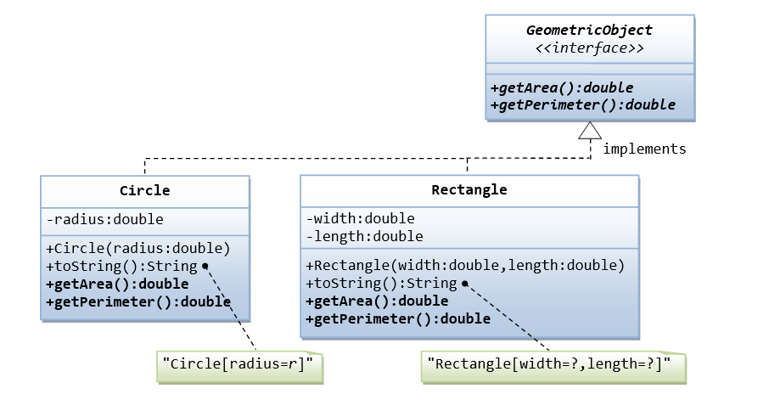
Interface Demo
Write an interface called GeometricObject, which contains 2 abstract methods: getArea() and getPerimeter(), as shown in the class diagram. Also write an implementation class called Circle. Mark all the overridden methods with annotation @Override.

Slide 7
Comparable interface
Comparable is an interface for comparing two objects of a class by overriding the method compareTo()
  public int compareTo(Object other); define the logical comparision between 2 objects(this and other), return:
  + positive number if this>other
  + ==0 if this=other
  + negative number if this<other
  public class Student implements Comparable<Student>{
  private String id, name;
  public int compareTo(Student s){
  return this.name.compareTo(s.name); }
  Arrays.sort(m); sort array m in ascending order with array elements comparable

Slide 8
Functional interface – lambda expr.
Functional interface is an interface with only one abstract method for doing something..
  Comparable, Comparator, Predicate, Runnable
Predicate interface declares test() method to check whether an object satisfies a certain condition or not.
+ public boolean test(Object a);
Predicate interface: effectively used in searching by different criteria without writing multiple search functions -> by using lambda expressions, no need to code implementation class.

Slide 9
Lambda expression
Lambda expressions are similar to methods; lists the arguments (left side) and the body of the method (right side) that handles those arguments
  (lambdaParameters) ->{ lambdaBody}
  (int x, int y) -> x+y
For example, this search function when called will be passed a lambda expression containing the search criteria
  public ArrayList search(Predicate<Student> p) {
  if(p.test(element)) addElementToSearchResult();
  }
Search by name starting with S and find birthday before X
  search(Student s -> s.getName().startWith(“S”))
  search(Student s -> s.getDob().before(X))

Slide 10
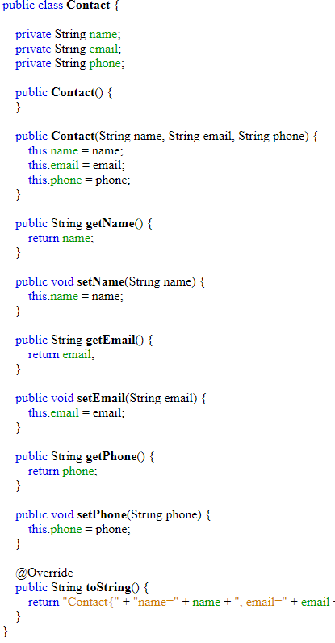
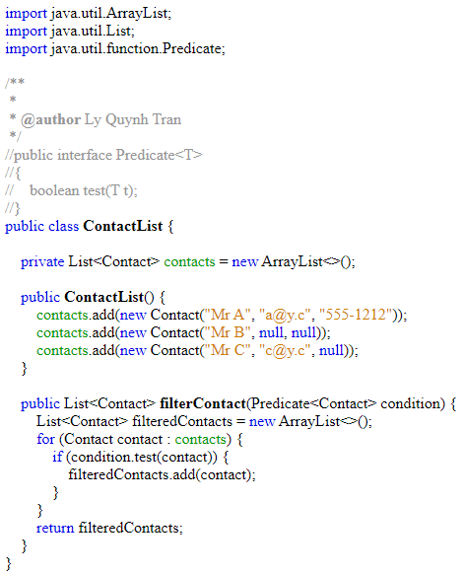
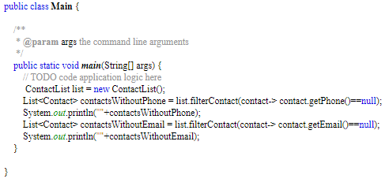
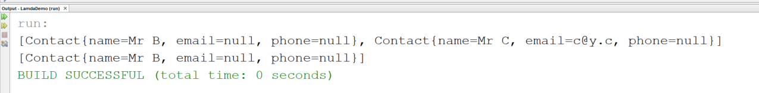
Lambda expression demo

Slide 11
abstract class–abstract method
abstract method is a method that does NOT define a body
  public abstract void doSomething();
abstract class is declared using the keyword abstract and contains abstract methods
  public abstract class Menu {..
  public abstract void execute(int n);
  }
Important note
  Can NOT create the instance of abstract class using new if NO overriding the abstract method is supplied
  Abstract class along with interface and sub-class are 3 levels of inheritance in Java

Slide 12
Packages
Package in Java is a folder contain a group of classes, sub packages and interfaces. Packages are used for:
  Extend class naming space, prevent naming conflicts.
    For example there can be two classes with name Employee in two packages, college.staff.cse.Employee and college.staff.ee.Employee
    Full class name including package name java.io.Reader
    Undeclared package: unnamed package – current directory

Slide 13
Packages
Defining the scope of access
  Classes in the same package can access each other without declaring access scope
Using keyword import for referencing classes from other packages.
  When not declaring import, specify the package name before the class name
  java.util.Date d= new java.util.Date();

Slide 14
Organize Packages
To organize the package, we make the classes become the members of package
  First, declare package before creating the class
    package mypackage;
    public class Hello {}
  Then, all the classes created later will store in the folder named package
  Package names should start with a lowercase letter to distinguish them from class names
Compile packages
  The -d parameter.
  javac – d C:\Temp Hello.java
    Will automatically create mypackage folder in C:\temp and save the Hello.class code in that folder

Slide 15
Using Packages
  Using import to specify the package that refers to the classes
    import 1 class of the package :
      import java.io.Reader;
    import all class of the package :
      import java.io.*;
  Components such as class, interface declared public will be accessible from outside the package
  java.lang is the default import package for all class

Slide 16
Keyword Modifiers
Modifiers are keywords that modify declarations
  access modifiers other modifiers
  public final
  protected abstract
  private transient
  native
  synchronized
  static

Slide 17
static
Static
  Used with variables, functions, and blocks indicating shared components in a class
  Static function are not allowed to use 'this'
  Static functions are not allowed to be overriden by non-static functions
  The code placed in the static {code..} block will be executed first when the Java program is run.

Slide 18
final
final
  Apply to class, function, variable
  final class does not allow inheritance
  final variable must be initialized when declared
  final method – not allow overriding
  final objects – the reference to the object is not allowed to change, but the value reference is mutable
  java.lang.Math is the final class

Slide 19
abstract
abstract
  Apply to classes and methods
  Abstract class is an incomplete class
    There are abstract methods but not defined
    public abstract int calculate();
  cannot initialize variables of abstract class using new operator
    Can be initialized with instance of anonymous class (provide ad-hoc override abstract method)
  Generates incomplete executable versions & allows partial customization of the class

Slide 20
Lab – homework
Define the interface Menu for user choice..
Write abstract class TextMenu which implements Menu,
  override all methods – except execute(..)
  execute() doing something base on user choice on menu.
Using TextMenu for Student Management Application
  Provides tasks for student management: add, update, delete, search..

Slide 21
Constructive Questions
Give an example of an interface already defined in the JDK library. Explain the use and meaning of that interface
Why we need interface?
Define an interface for an electric power consumption management application
Find the scenarios that need abstract function and abstract class
Compare inheritance characteristics of sub-class, abstract class and interface.
Define an interface, then write the abstract class implementing the interface and write a class that extend the abstract class. Choose the free topic

Slide 22
Constructive Questions
What are the characteristics of variables declared in the interface? Explain why these characteristics are default?
What is the purpose of package?
Compare functional interfaces, tag interfaces and interfaces
How can Arrays.sort(arr) and Collections.sort(list) sort the array arr/ an arbitrary list list?
Compare the two terms data abstraction and abstract class on the semantics of the word abstract
Give an example using synchronized keyword and explain its meaning.
Give an example using transient keyword and explain its meaning.

